Slide 1
Analysis of Mangroves in Gujarat Using DataCube
-Vasam Satvika Reddy

Slide 2
INTRODUCTION AND PROBLEM STATEMENT
TITLE ANALYSIS OF MANGROVES IN GUJARAT USING REMOTE SENSING DATA AND MACHINE LEARNING
GOAL Create a data cube and develop applications for monitoring and analyzing mangroves in Gujarat.
Focus Changes in area, health, and types of mangroves.
Areas
Technologies utilized:
Data Cube: Creating a comprehensive data cube for efficient storage and analysis of satellite data.
Remote Sensing: Gathering satellite data to monitor and analyze mangrove ecosystems.
Machine Learning: Applying ML techniques to analyze the data and derive meaningful insights.
Flask: Utilizing Flask routes and functions for data loading, analysis, and response generation.
Web Development: Employing HTML, CSS, and JavaScript for application development.

Slide 3
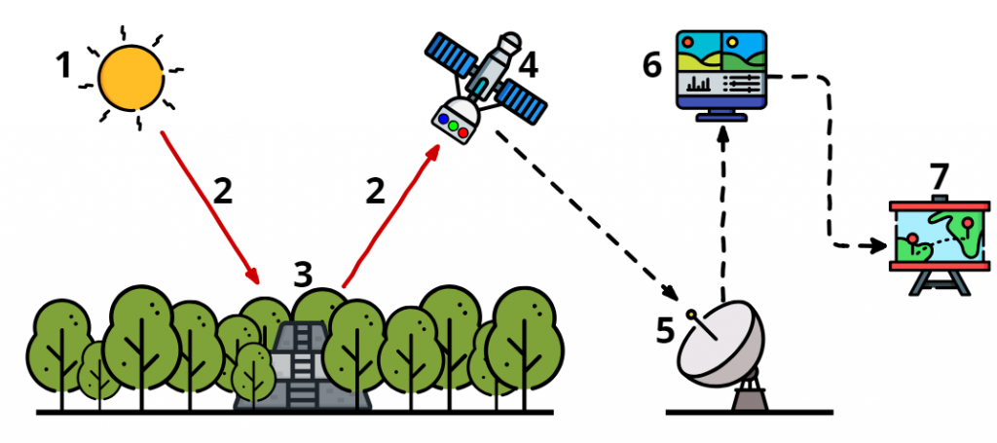
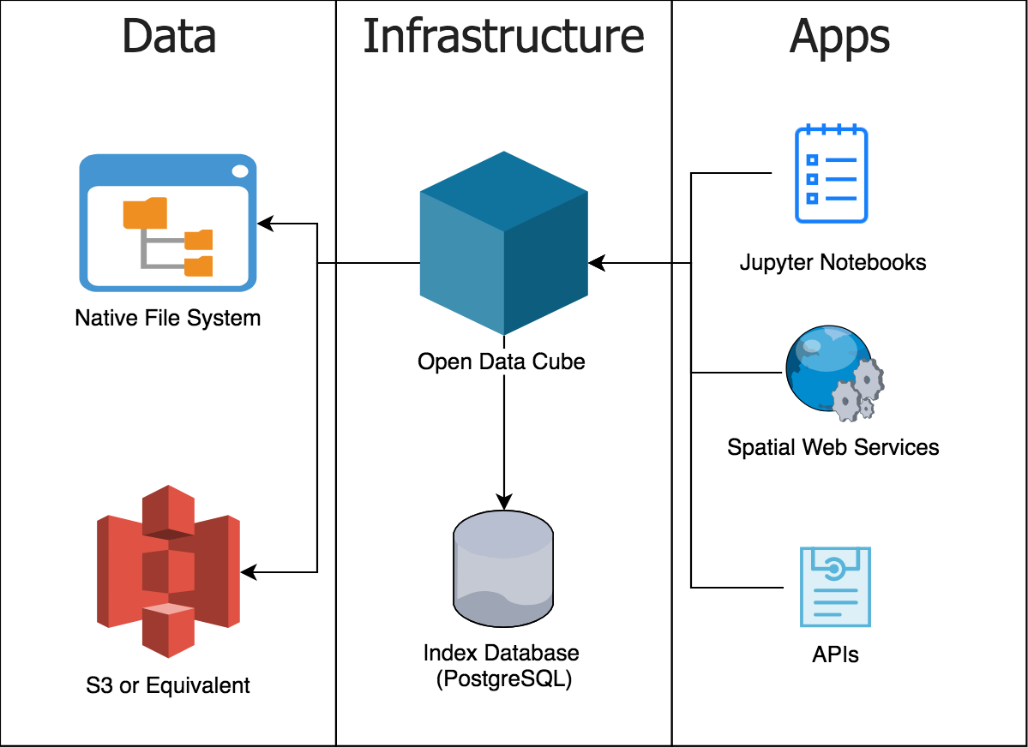
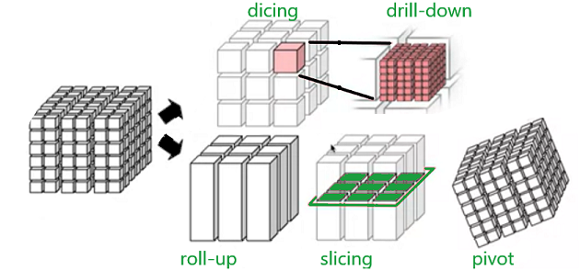
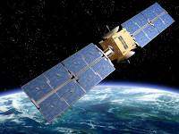
Remote sensing and Datacube

Slide 4
PROJECT WORKFLOW
Sentinel 2(1A,2A,2B)
Data Acquisition
Download Satellite data
s2-1A.yaml
(sentinel)
Landsat(7,8)
Satellite specific products
Product Creation
ls-8.yaml
(Landsat)
Data at band and pixel level is fetched and stored into products in database
Database
Ingestion
Ingest satellite data
ndvi
Feature Extraction
Extract relevant features
mvi
Area
Machine learning models
develop models
health
Analyze and Visualize the Datacube
types
Develop applications
Applications

Slide 5
CONCLUSION
The Analysis of Mangroves in Gujarat project can be used in the following ways:
Conservation Planning: Helps prioritize conservation efforts and protect important mangrove areas.
Environmental Impact Assessments: Evaluates the impact of development projects on mangrove ecosystems.
Education and Awareness: Educates people about mangroves and their significance through interactive tools.
Policy and Management Decisions: Informs policies and management strategies for mangrove conservation.
Research and Collaboration: Provides data for researchers to study mangroves and encourages collaboration in the field.
Overall, the project supports conservation, informs decision-making, raises awareness, aids research, and fosters collaboration to protect mangroves in Gujarat.

